Slide 1
Building Mobile Apps with .NET and Xamarin
James Montemagno
@jamesmontemagno
Maddy Leger
@maddyleger1
Xamarin Program Managers

Slide 2
Agenda
What is Xamarin?
Share more code with Xamarin
Tools for Xamarin Developers

Slide 3
What is Xamarin?
Notes:
Maddy: before we get into it, one thing we get asked all the time by .net devs is -- what is Xamarin?
James: the way I like to say it is…

Slide 4
An open source app platform
from Microsoft for
building modern & performant
iOS, Android, macOS,
watchOS, & tvOS apps with .NET.

Slide 5





























Xamarin
Loved by developers, trusted by enterprise
Notes:
Xamarin has been around for over a decade – and there are tons of companies that entrust Xamarin and .NET today.
In fact there are a plethora of developers at all sizes of companies using Xamarin erry dayyy

Slide 6





Productive environment
Maximize code reuse
Native performance & integrations
Expansive ecosystem
Notes:
James: The reason so many companies trust us is….

Slide 7
How does it work?

Slide 8

Xamarin App Architecture
.NET
C#
C#
C#
Shared C#
Business Logic • Platform APIs • User Interface
Shared C# codebase • Native API access • High performance
Notes:
Maddy - First, it is with it’s unique application architecture. In fact it is the .NET architecture itself. You decidde what platforms you want your apps to run on, we call them head projects.
You can access all of the native APIs for each and share a bulk of the C# logic. Here we see business logic, platform APIs, and user interfaces. This can scale to a lot or a little based on what you are trying to achieve. So how exactly does this work?

Slide 9












Native API access
Notes:
James - The first part in the head projects is access to any of the unique APIs in iOS and Android. You have access to them all in C#. Now, these do have to be written in the head project and aren’t shared since they are unique to each platform. However, the Xamarin team has a way to help us out there.

Slide 10

Xamarin.Essentials
Secure Settings
Sms
Preferences
Flashlight
Clipboard
Gyroscope
Magnetometer
Geolocation
Phone Dialer
Device Display Info
Email
Device Info
Battery
Compass
Accelerometer
Screen Lock
Data Transfer
Text to Speech
Geocoding
File System
Connectivity
Vibration
aka.ms/xamarinessentials
Notes:
James - Which is Xamarin.Essentials. An open source library that abstracts common native features into a single cross platform API for iOS, Android, and Windows. These are APIs that exist across each platform so why not bring them together.

Slide 11

Beautiful cross-platform UI with Xamarin.Forms
Notes:
Maddy - What about the user interface? Just like APIs you can build the native UI for each platform. However, many developers choose to share all or most of the UI with Xamarin.Forms
Xamarin.Forms has over 60 controls built in, including your standard controls like images, buttons and controls that you wouldn’texpect - like collectionviews, carousel views, and media element
and a rich vendor ecosystem, and a lot of community stuff too!

Slide 12
Xamarin.Forms: Cross-Platform Native UI
.NET
C#
C#
C#
Xamarin.Forms - UI
Xamarin.Essentials
Shared C#
Business Logic
Notes:
Maddy- This is our diagram from before but with even more shared code - device APIs and UI - and we can see a full picture of what goes into our app.
You can mix and match, to0ooooooo
Use as much xam essentials and xam forms as your app needs

Slide 13














Libraries & Tools
Cognitive
Services
Azure Active
Directory B2C
Zxing
Barcode
Scanning
Akavache
Gorilla
Player
Zeplin
Notes:
James - Like maddy said before we have a rich vendor ecosystem

Slide 14
Demo
Maddy
File -> new dialog
What does a project look like?
Debug Locally
Item template for collectionview from scratch with Hot Reload
Hardcoded data ahead of time
Make changes to hard coded data, copy paste more monkeys
Add a backend
Add connectivity
Use HttpClient
Use System.Text.Json (.Net core 3 features!)
Set data context in XAML
Dual-deploy
Awesome, let’s make a style change to button
James
You can also build… watchOS, tvOS, macOS apps…
Show off Android project, designer, IntelliSense
Apply Changes?
Show off packaging & uploading
Maddy
Dual-screen

Slide 15
Demo

Slide 16
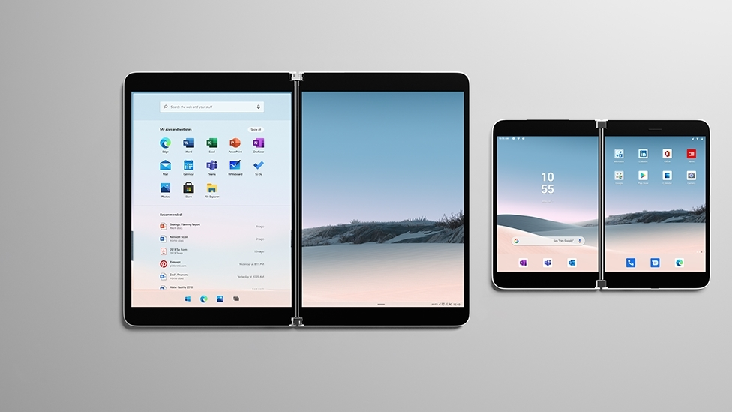

Slide 17
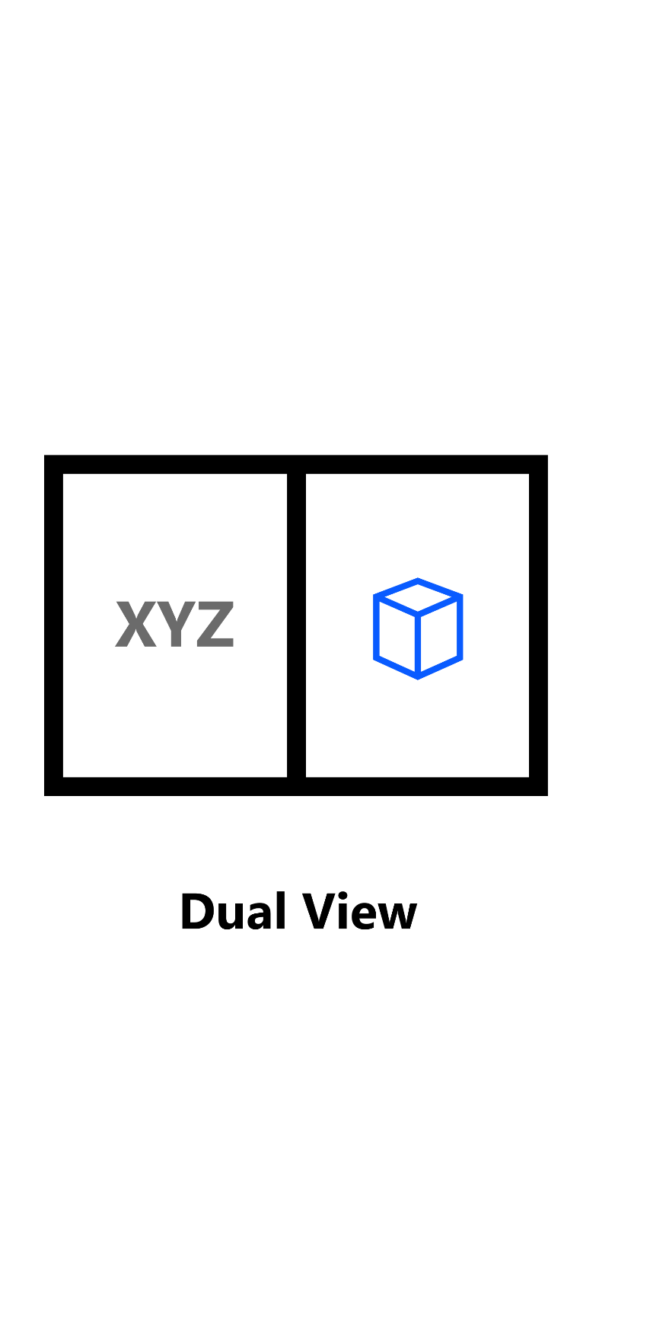
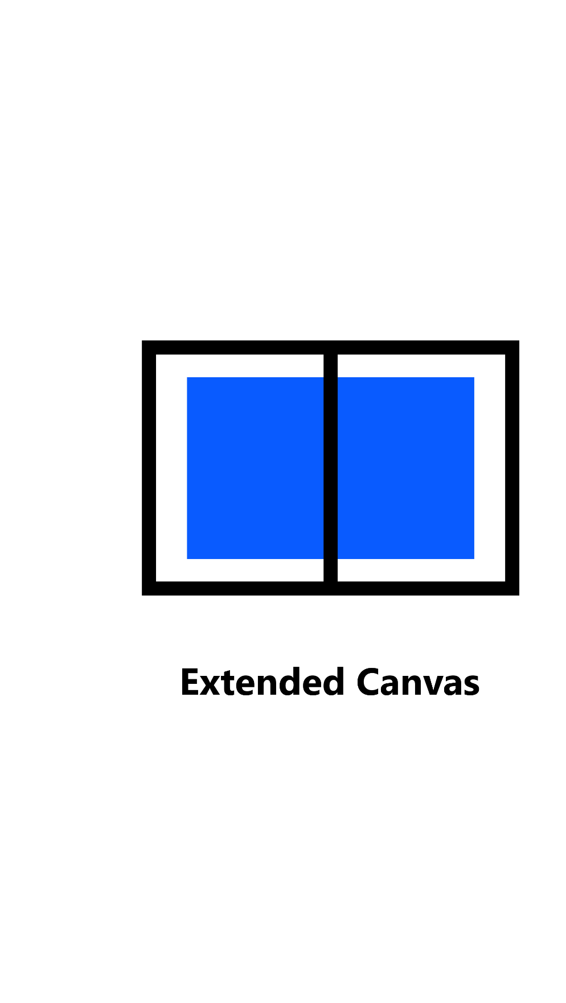
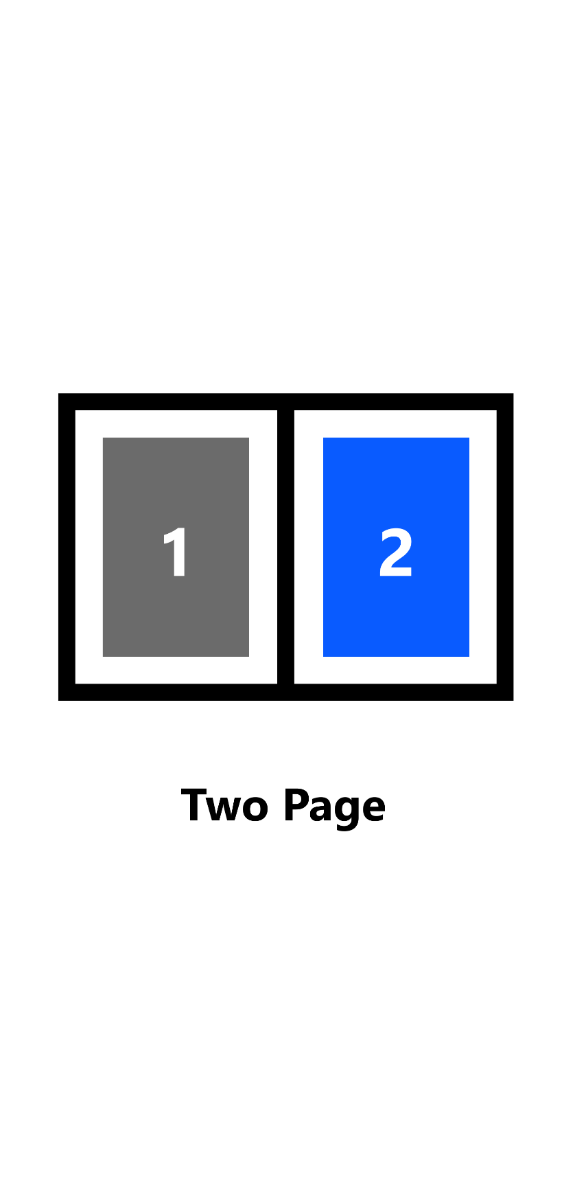
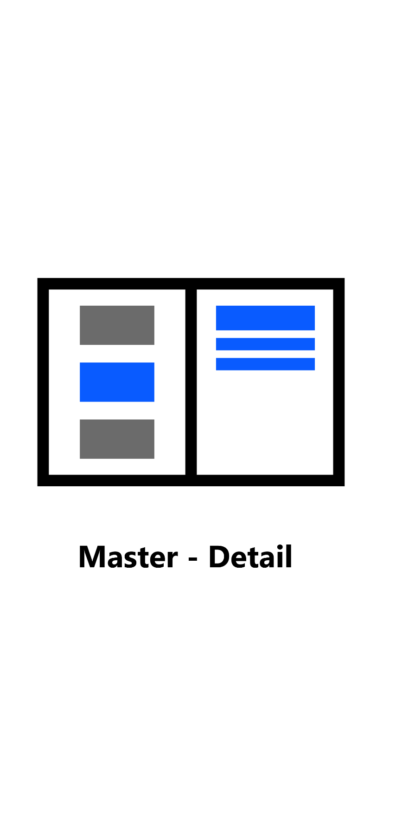
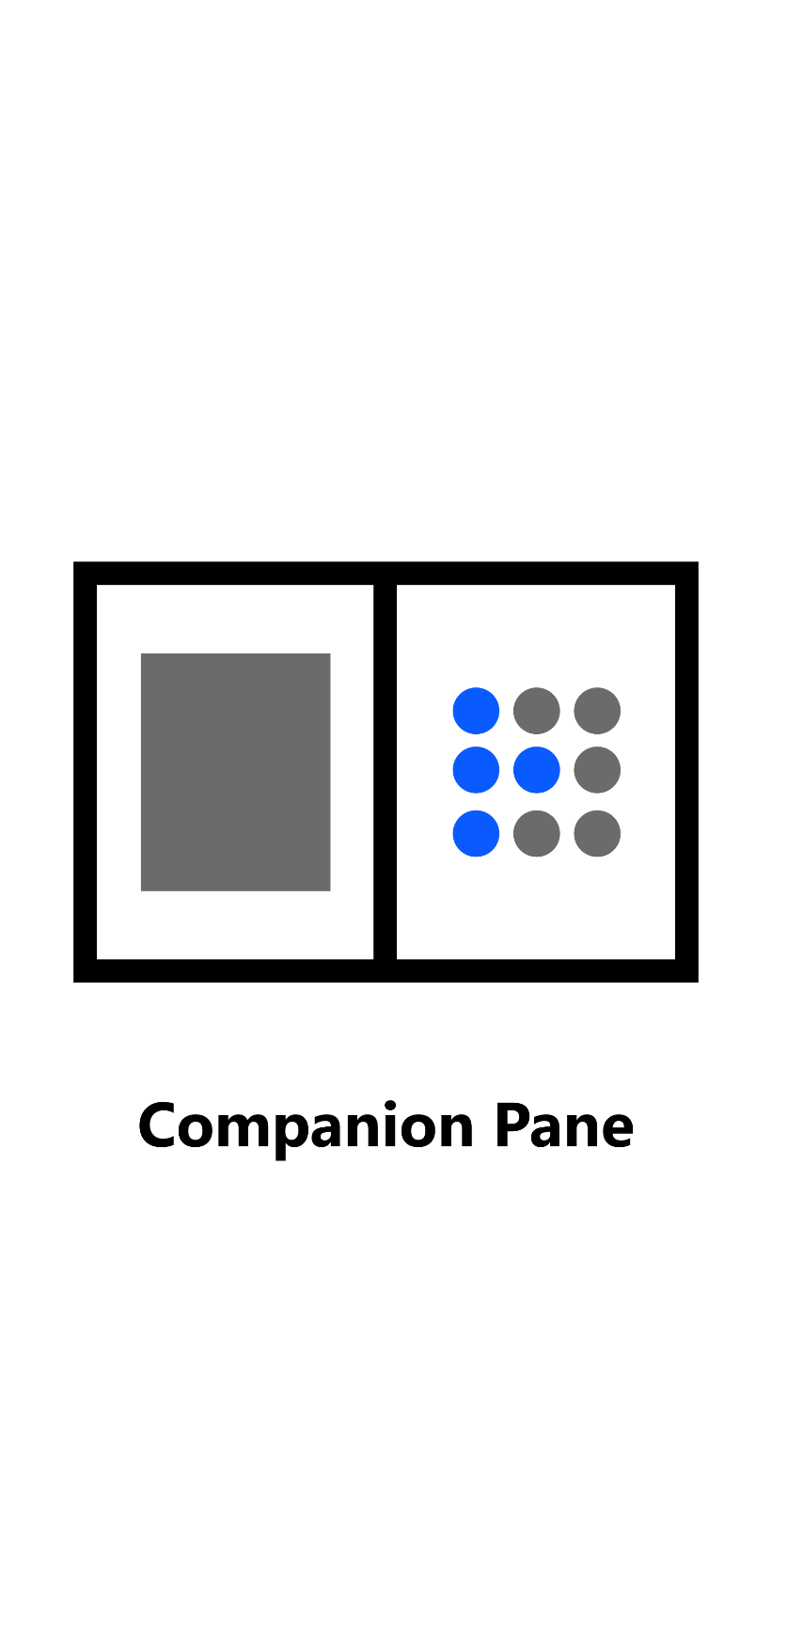
Dual-screen patterns
Connected apps
Expansive workspaces
Focused screens

Slide 18
Introducing: Xamarin.Forms.DualScreen

Slide 19
Get started today
xamarin.com

Slide 20
Awesome resources
Documentation
https://docs.microsoft.com/xamarin/
https://docs.microsoft.com/dual-screen/
Samples
https://github.com/maddyleger1/MonkeysRefresh
https://github.com/microsoft/surface-duo-sdk-xamarin-samples
https://github.com/xamarin/app-xamarintv
Reach Out
@JamesMontemagno
@MaddyLeger1

